Slide 1

3D Puzzle 3D printing algorithms course
Roy kinamon & alon mendelson

Slide 2
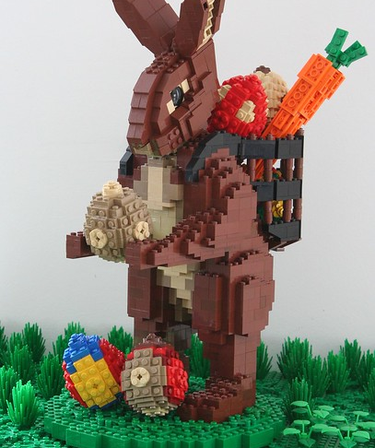
Outline and Motivation
Motivation
gain experience with 3D algorithms coding and hands on 3D printing
Outline
Input: 3D body for print
Output: Set of 3D printable puzzle pieces:
Built into original shape
Maintain stability and strength
Efficient run time and easy printing

Slide 3
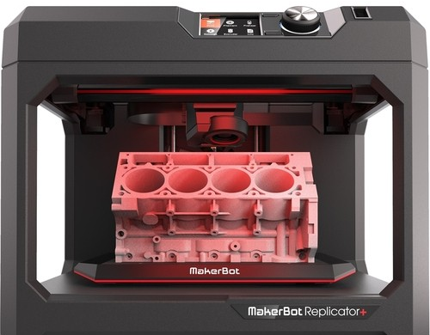
Framework
3D representation and manipulation
Trimesh
Blender and OpenScad (for Boolean operations)
Printing
MakerBot Replicator

Slide 4
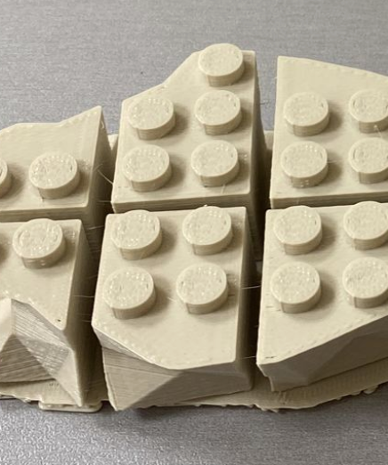
Algorithm stages – Slicing along Z
Optimize to keep cross section above minimal area
Keep continuity in xy plane
Represent slices with a Boolean grid of contained bolts and voids

Slide 5
Algorithm stages – Plan X-Y Slicing
Recursive algorithm with greedy approach. runs on the Boolean representation with constraints:
Pieces not too big and not to small
Strong connection to adjacent layers
No overlapping cuts between adjacent layers
Represent slicing as tree

Slide 6
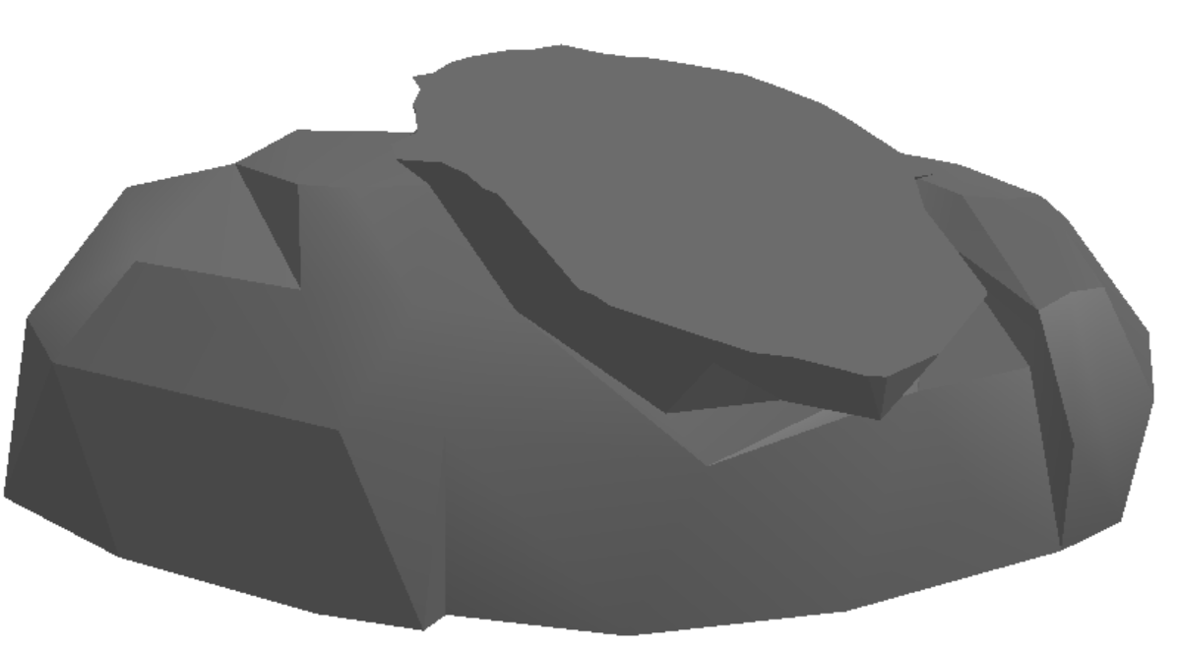
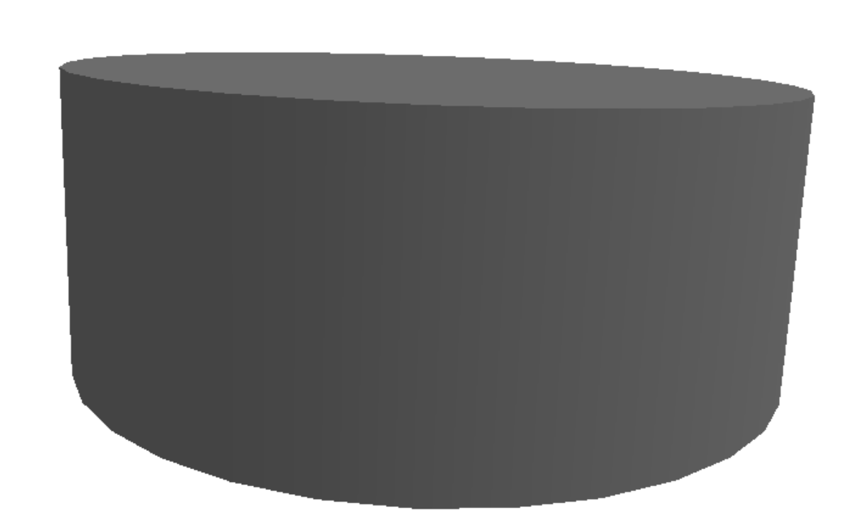
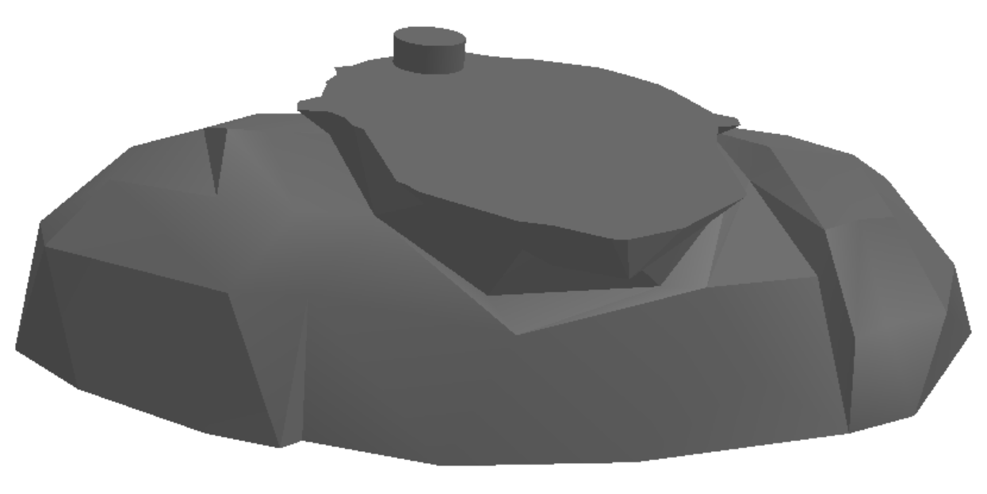
Algorithm stages – Add “Connectors” and slice
Add the bolts and the voids to each layer using Boolean operations
Perform slicing along x-y with recursive algorithm

Slide 7
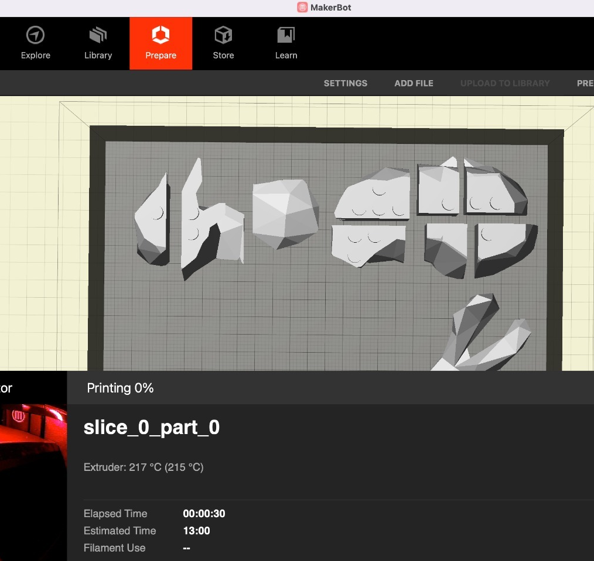
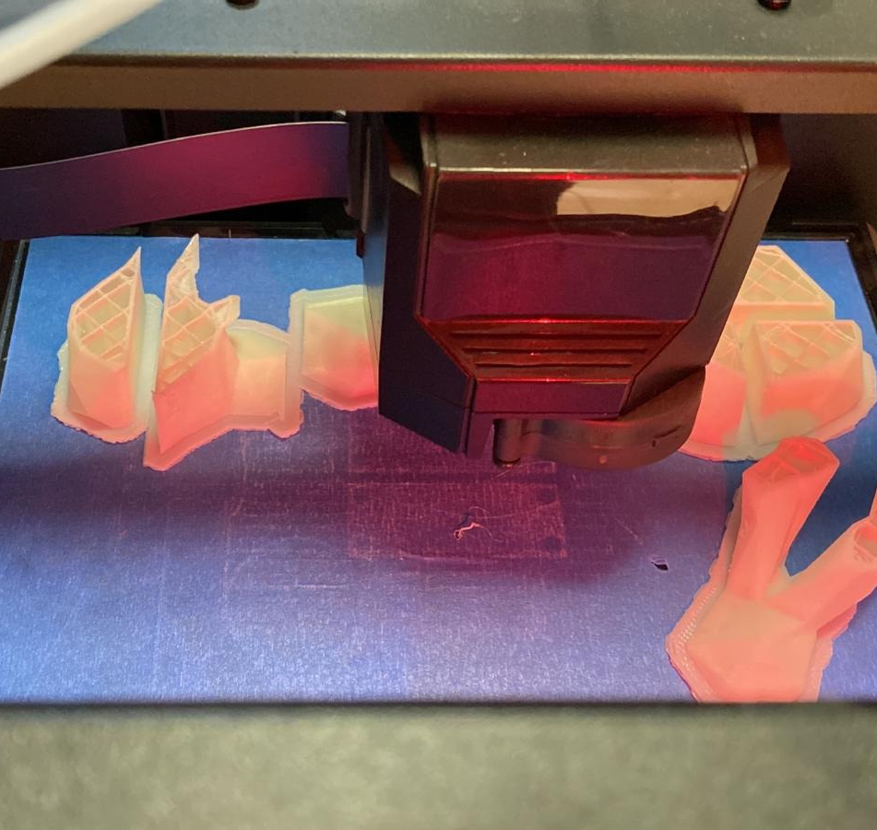
Print initial model with MakerBot replicator

Slide 8
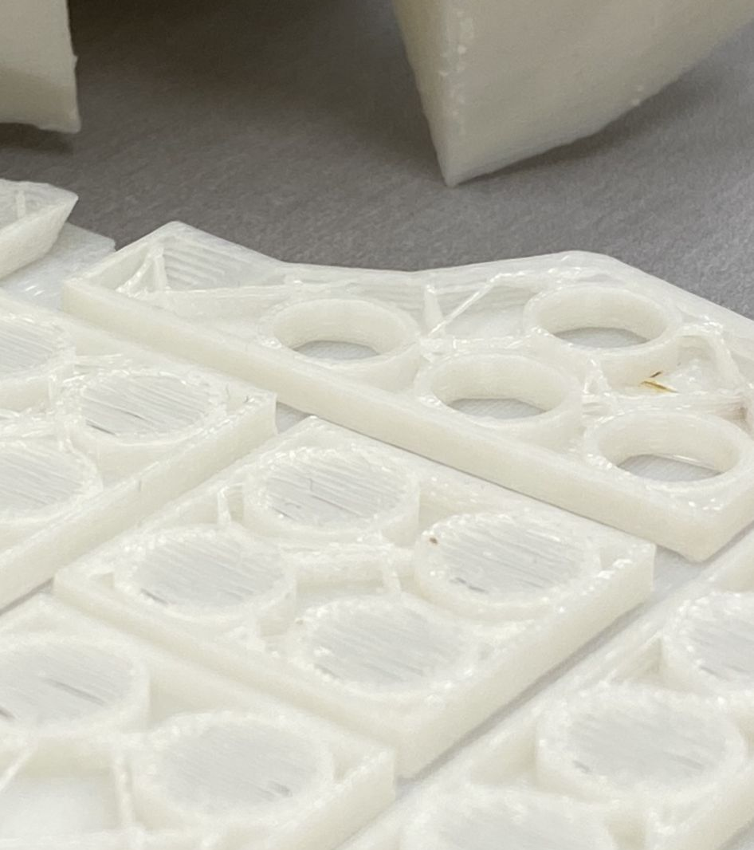
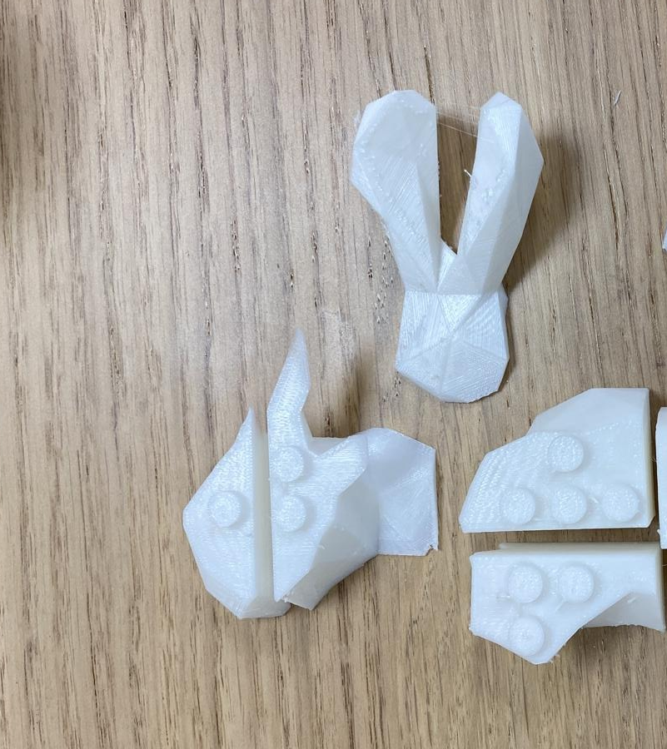
Bolts and voids Fine Tuning
First printed model was hard to assemble – pieces didn’t attach easily
Requires to adjust bolt and voids dimensions for ease of assembly but MakerBot resolution is low
We tried many different dimensions to find the best fit that:
Maintains physical strength
Pieces attaches and detaches easily
“bridging” stays tensed

Slide 9
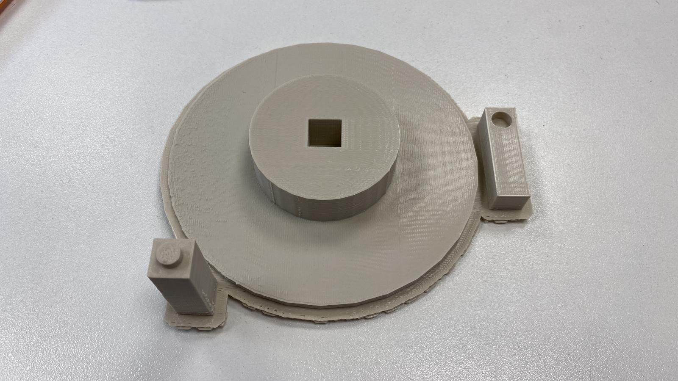
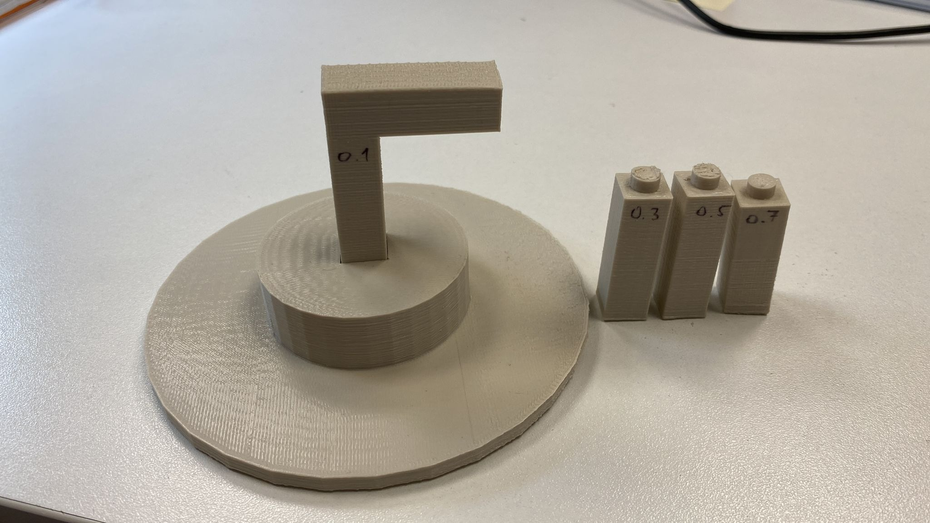
Optimizing Structure strength
P
d_{xy}
Measuring strength of single bolt over moment
Calculate total structure length and siameter
Trial 1 – make it stand - aborted
Filling
Shape
Trial 2
Modifying bolt dimensions from friction to
breaking pressure / flexural strength
h_{xy}

Slide 10
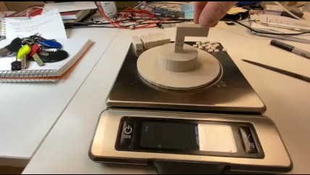
Testing Bending moment
Optimizing Bolts and Voids Daimeter and height
Optimizing printer parmaeters per part:
Layer height
Infill density
Infill Pattern
No. of shells
roof/Floor Thickness
For example at 0.1mm, 10%, Diamond, 2, 0.8mm ->
Breaking point at 40N with 2.5cm resul in:
1Nm breaking moment

Slide 11
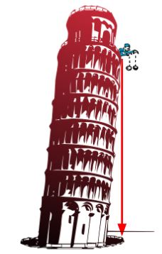
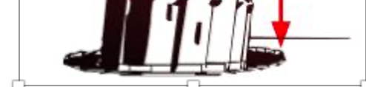
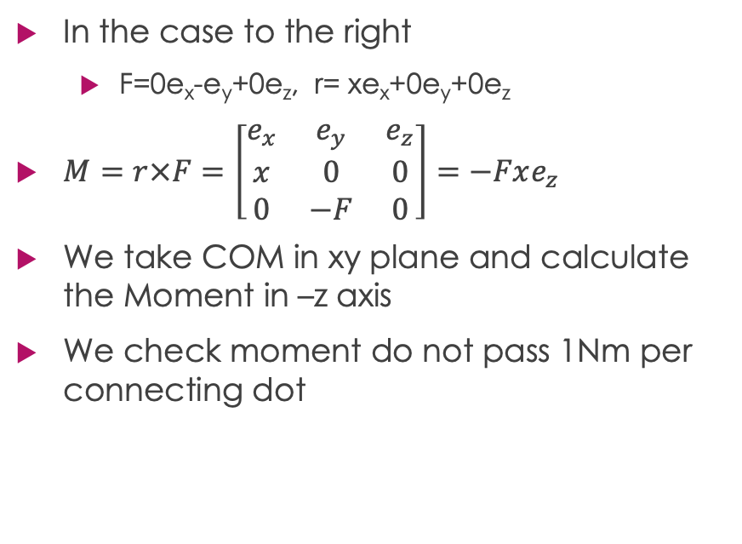
Adjusting strength
y
In the case to the right
F=0e_{x}-e_{y}+0e_{z}, r= xe_{x}+0e_{y}+0e_{z}
$M=r×F=\left[\begin{matrix}e_{x} & e_{y} & e_{z} \\ x & 0 & 0 \\ 0 & −F & 0\end{matrix}\right]=−Fxe_{z}$
We take COM in xy plane and calculate the Moment in –z axis
We check moment do not pass 1Nm per connecting dot
x

Slide 12
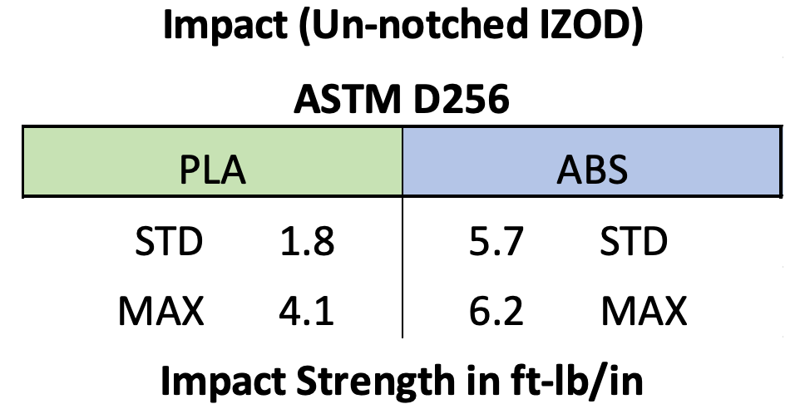
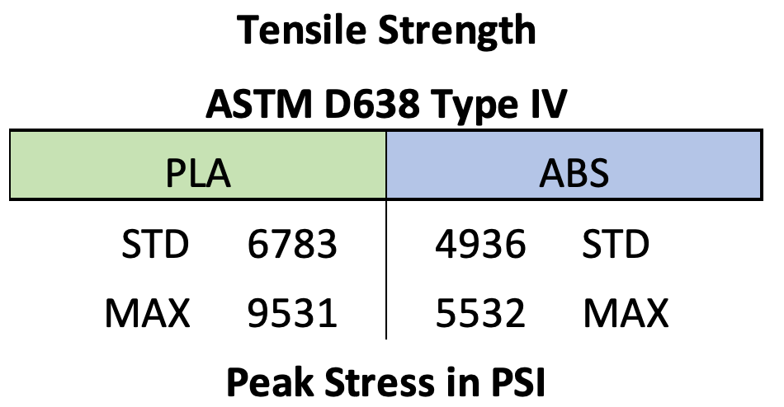
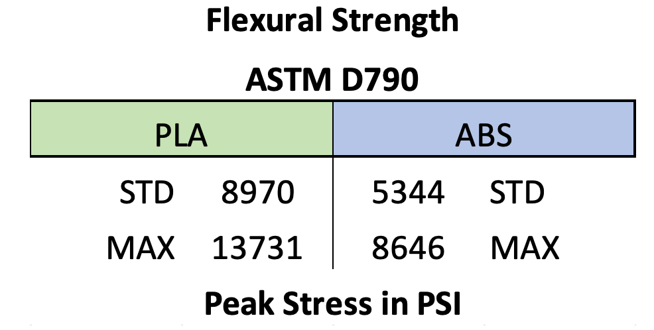
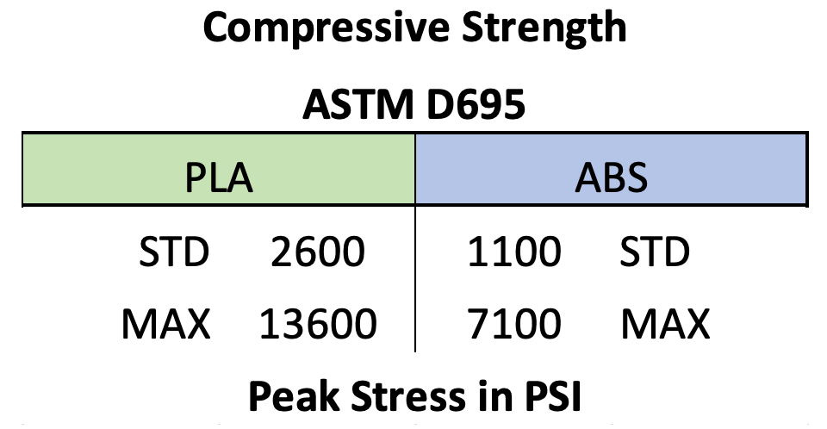
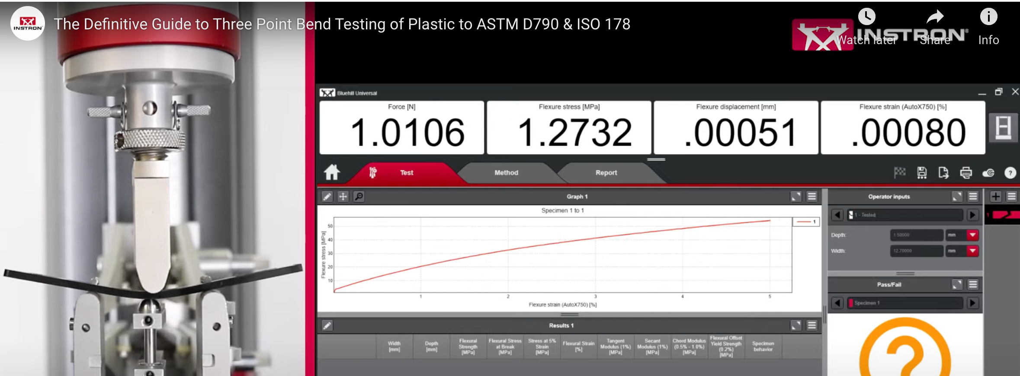
Optimizing Structure strength
Increase height and break resistance
Infill (Higher infill for a stronger part)
Shells (More shells for a stronger part)
Print orientation, size or design
Increase diameter of bolts till meeting flexural strength

Slide 13
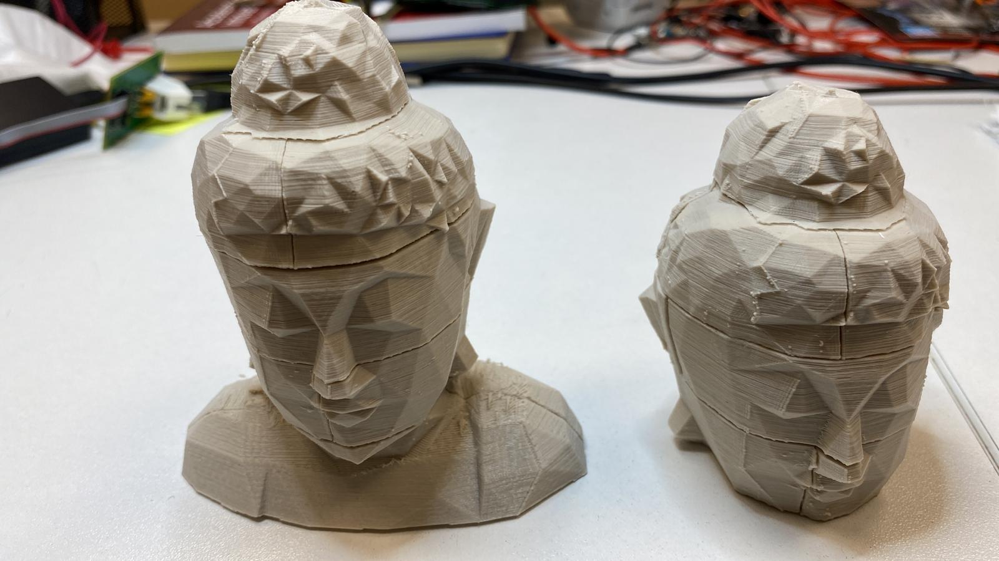
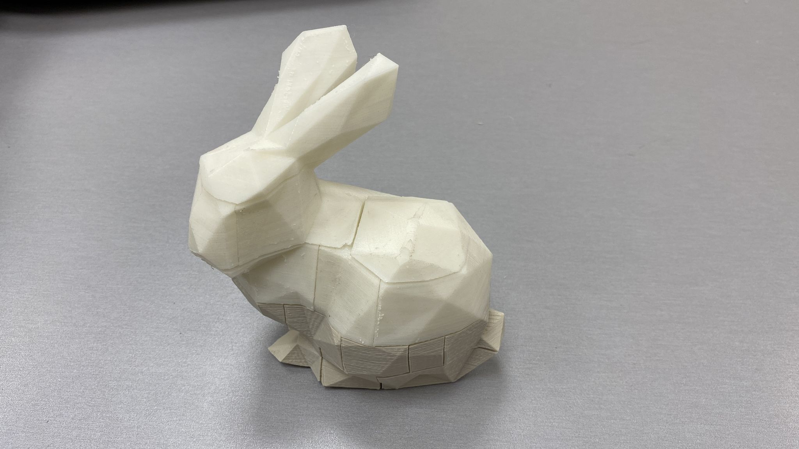
Results
Budhaa
Bunny
Print time (hours) | Algo runtime (mins) | No. pieces | Size (cm)
~11 | ~3 | 12 | 10X5X12 | Budhaa
~17 | ~7 | 23 | 10X6X13 | Bunny

Slide 14
Challenges
Trimesh and Blender are unstable
Transition to OpenScad
Printing
Alignment and Calibration
Quality
Duration
“Debugging” is costly

Slide 15

Thank You

